Slide 1
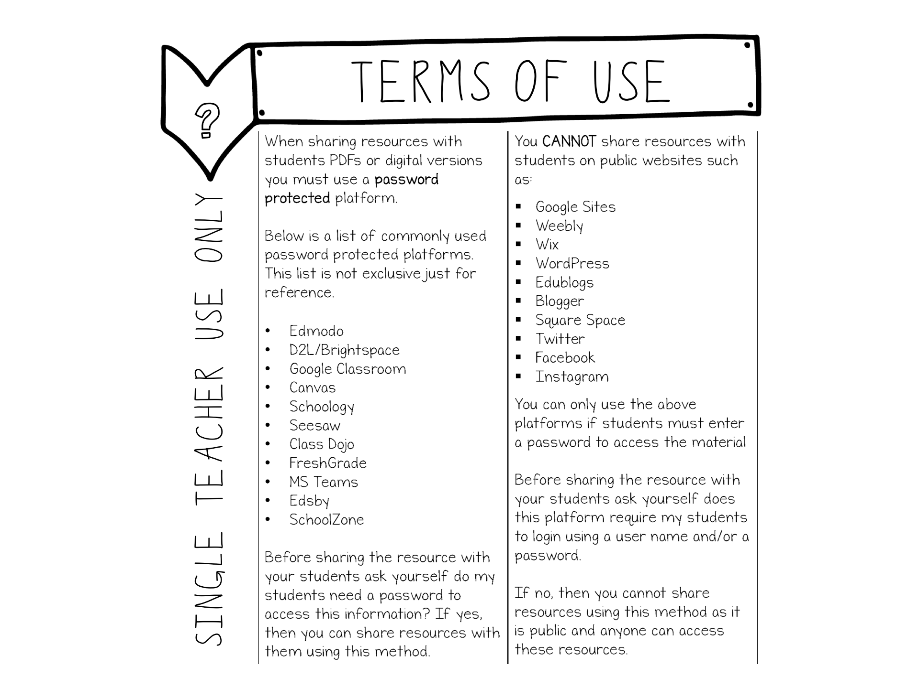

Slide 2
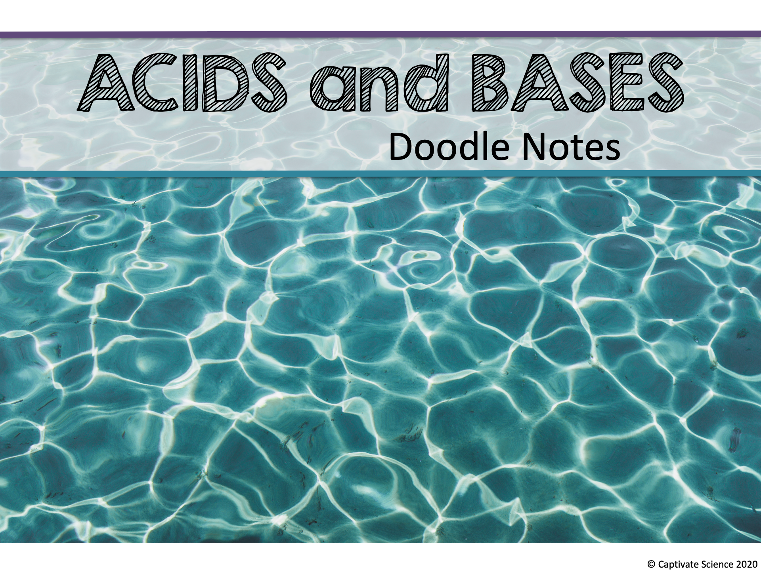

Slide 3

Watch one or more of these short videos to get your mind thinking about the pH scale, acids and bases.
What are Acids and Bases- Chemistry Basics (American
Chemical Society
Acids and Bases (Ted Ed)
Pay attention to how these substances are acidic or basic based on the behavior of their molecules!
Today’s lesson will be organizing information using doodle notes to help you better understand the pH scale.

Slide 4
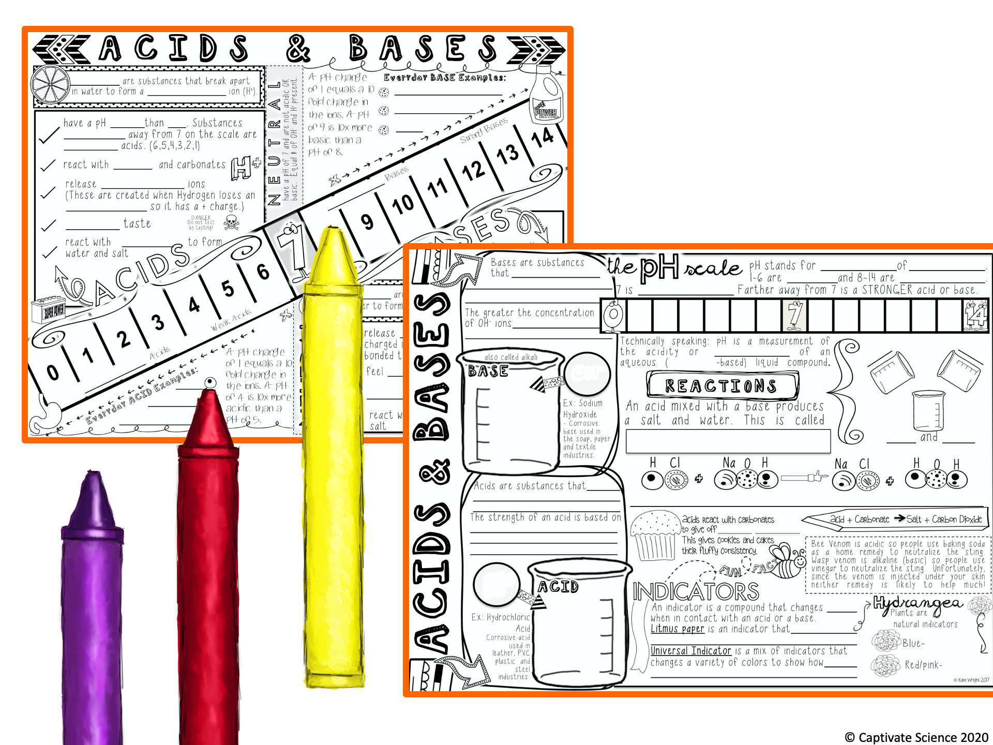
ACIDS and BASES
DOODLE NOTES

Slide 5
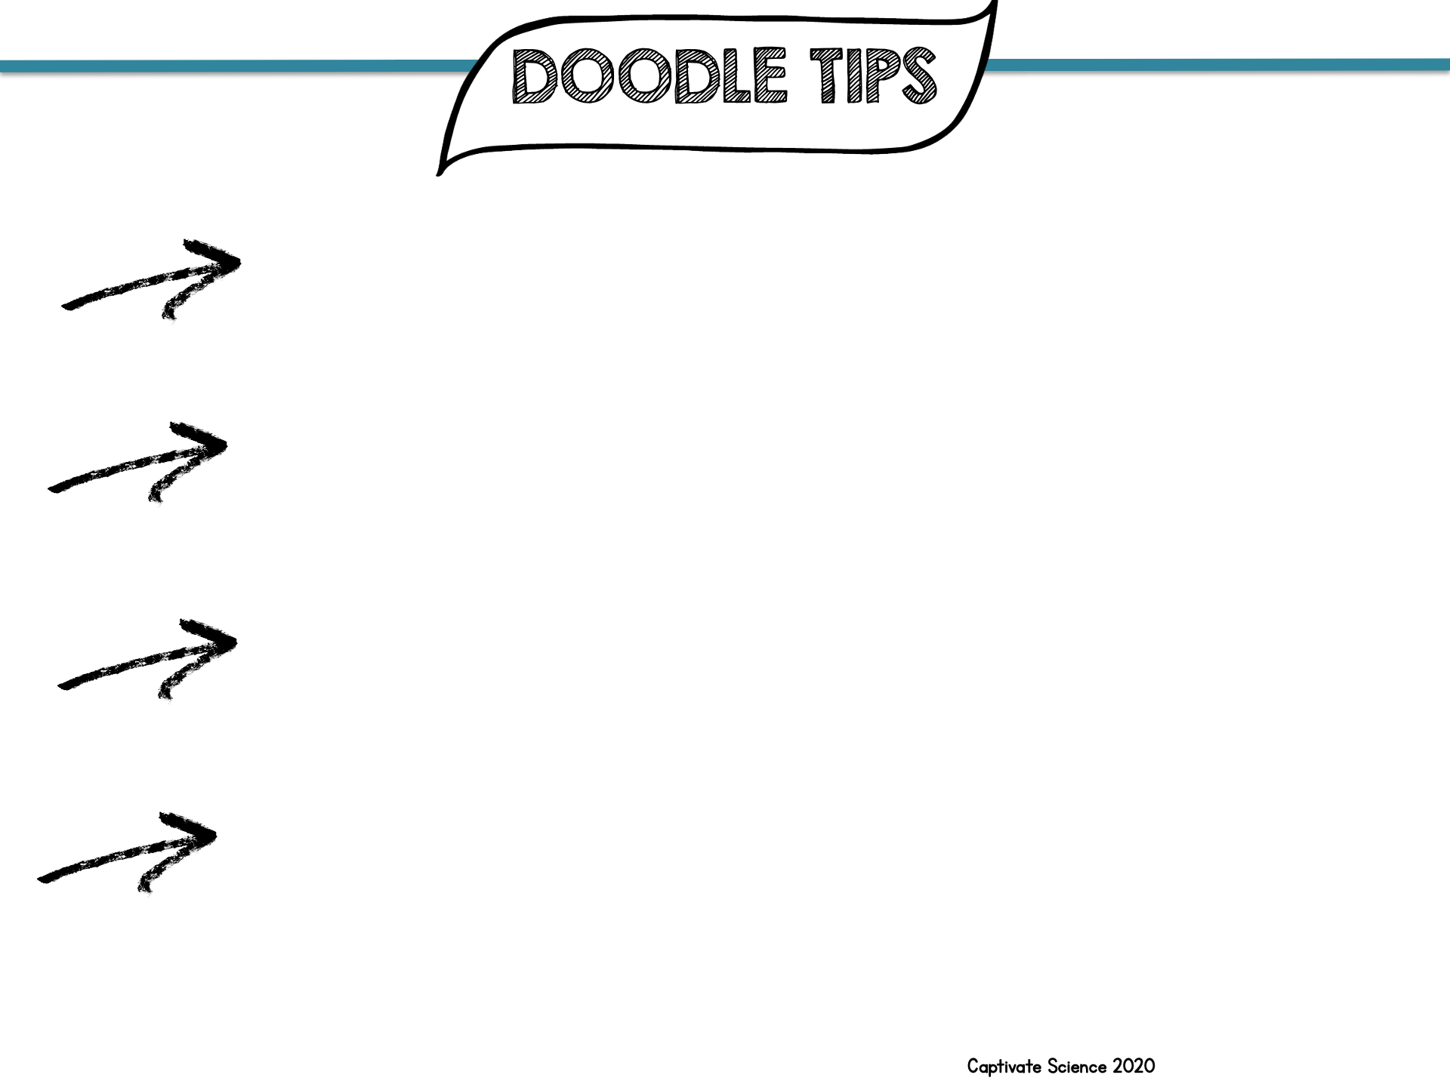
You will need a regular pencil or pen for writing key ideas neatly!
Colored pencils work best for adding color. If needed, use only fine-tip markers and use them sparingly so that they don’t overpower the page.
Focus on the main ideas. Don’t stress if you don’t get everything perfectly colored right away. Adding more color and detail later will help you study your notes!
Listen for doodle tips that will help make your notes easier to remember and study. Doodle notes take some work, but you will notice that they really help you learn!

Slide 6
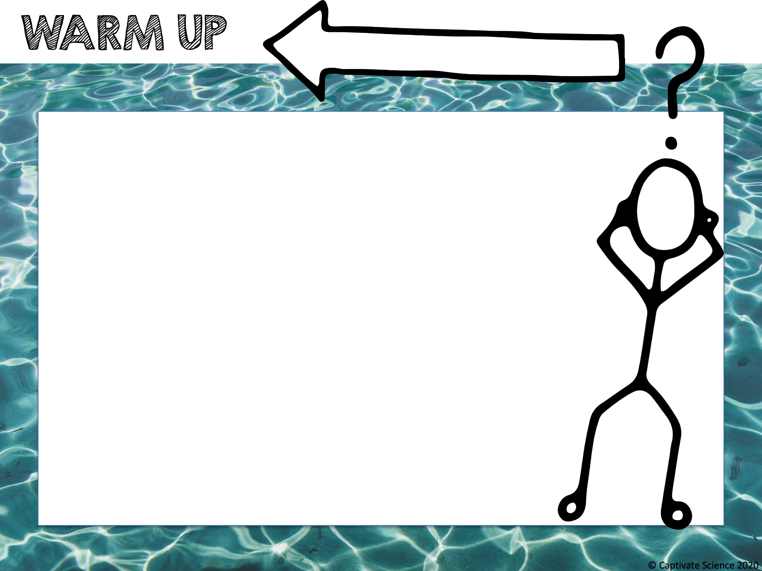
The pH of a solution is a measure of the concentration of hydrogen ions in the solution.
Chlorine is used to sanitize pools and keep them safe for swimming.
Chlorine works best to disinfect a pool only when the pool water has the correct pH.
Do you think pools need a high pH (basic), low pH (acidic) or neutral pH to be suitable for swimming?

Slide 7
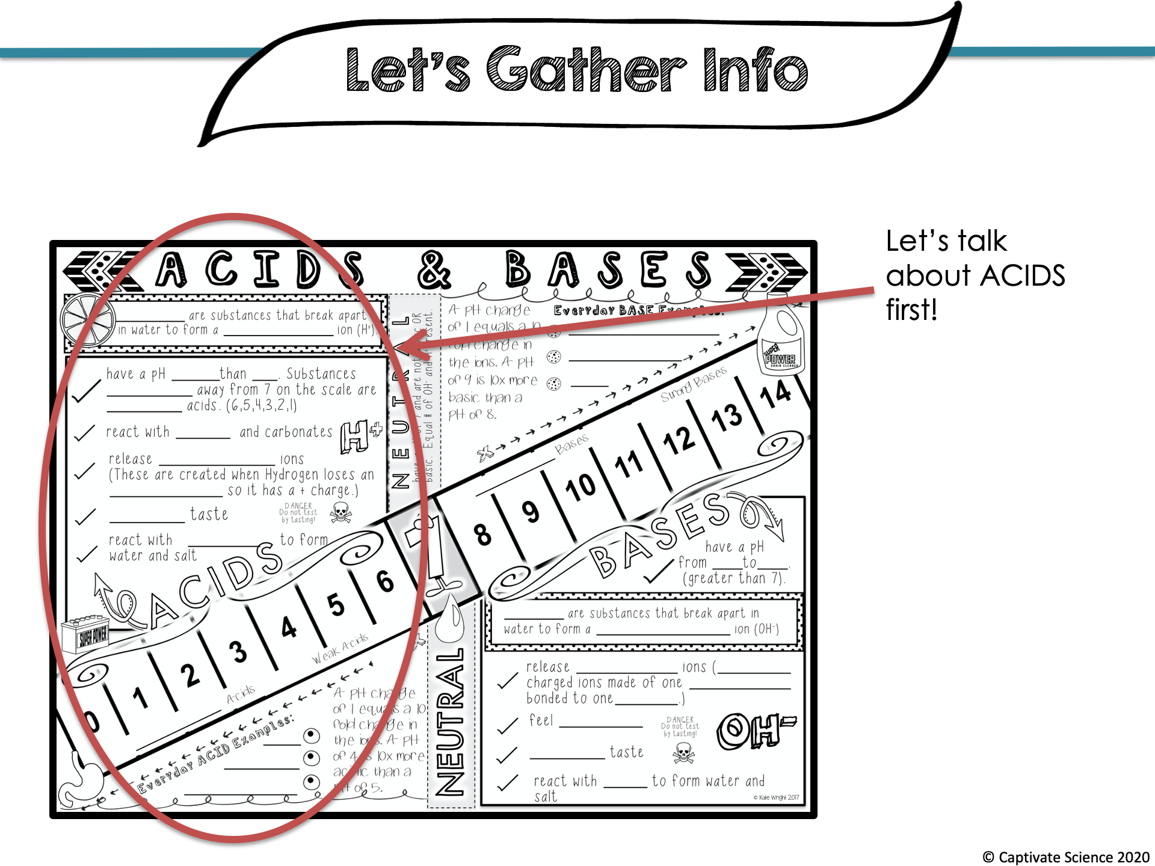

Slide 8
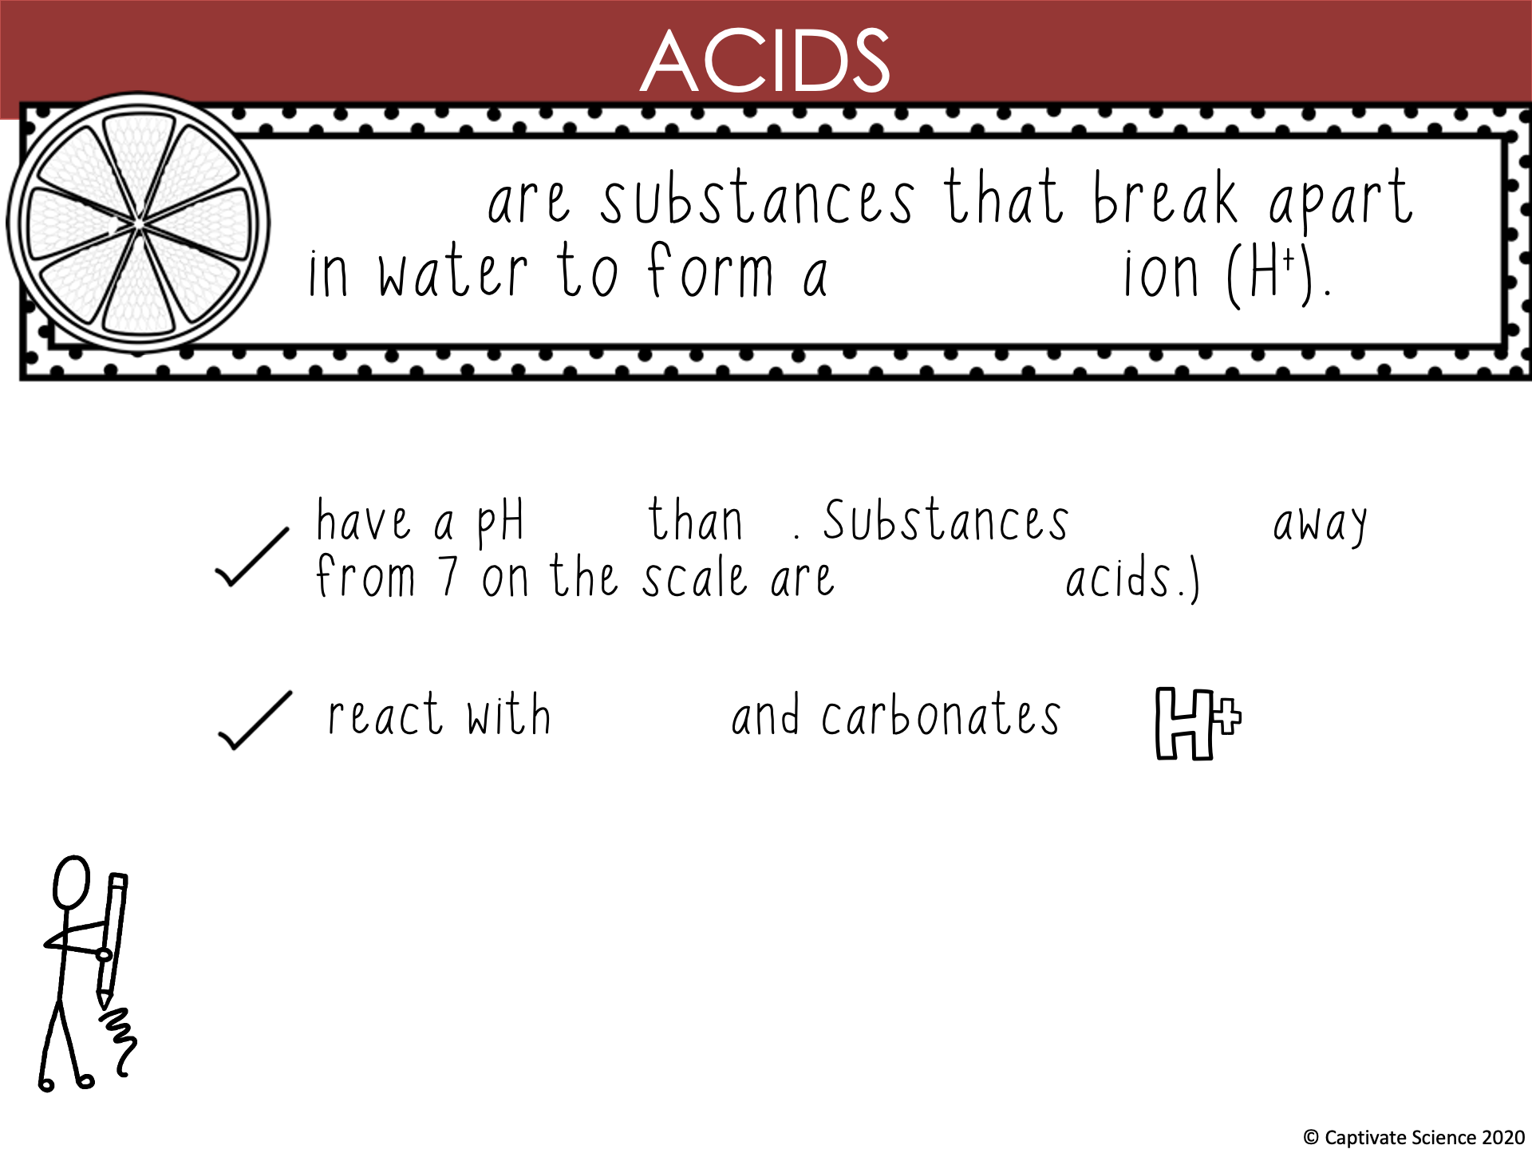
Acids
hydrogen
less 7 farther
stronger
metal

Slide 9
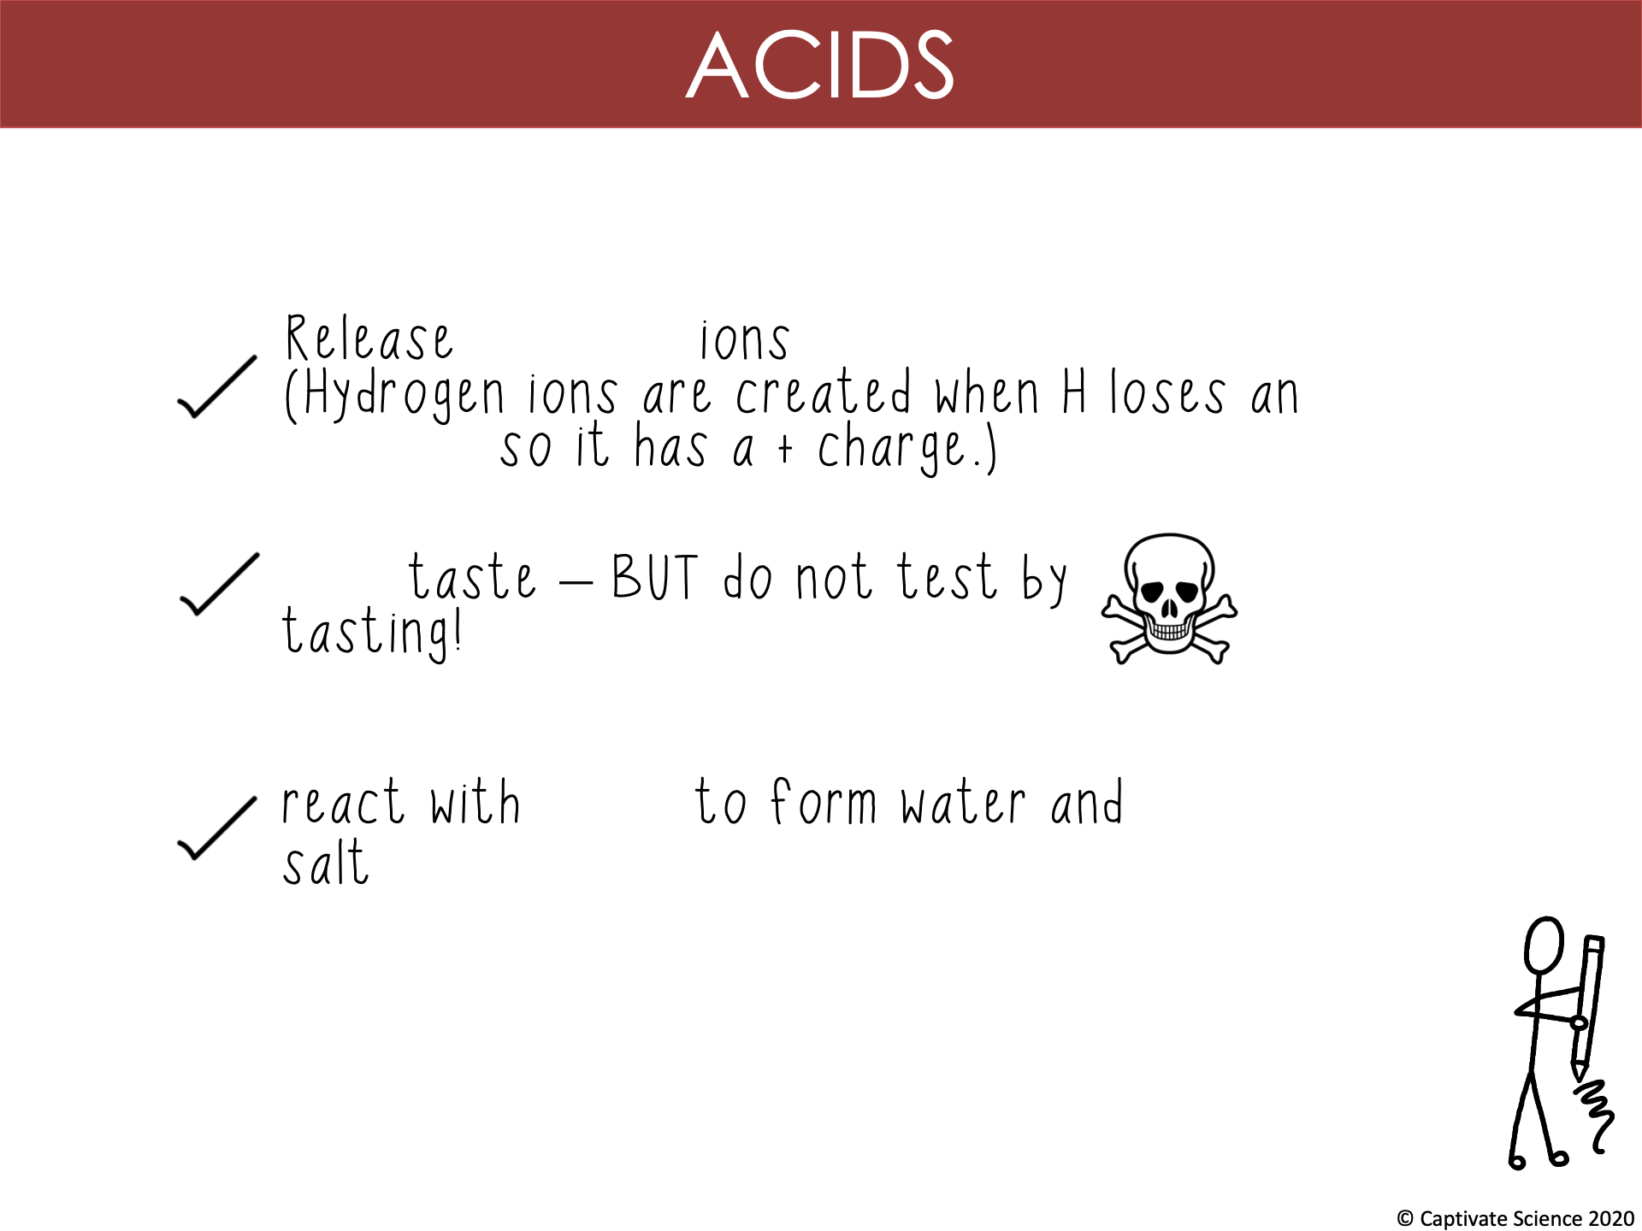
hydrogen
electron
sour
bases

Slide 10
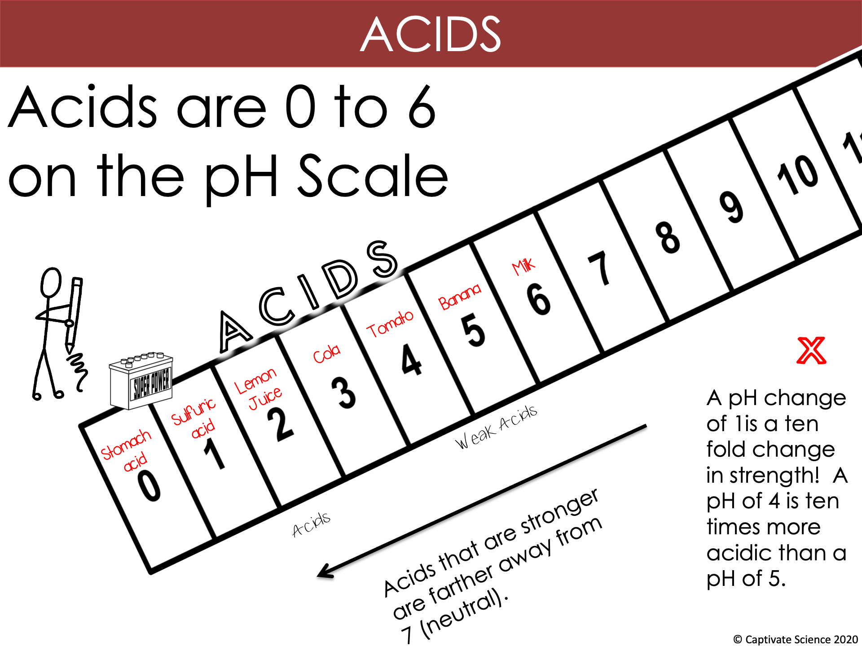
10
STRONG

Slide 11
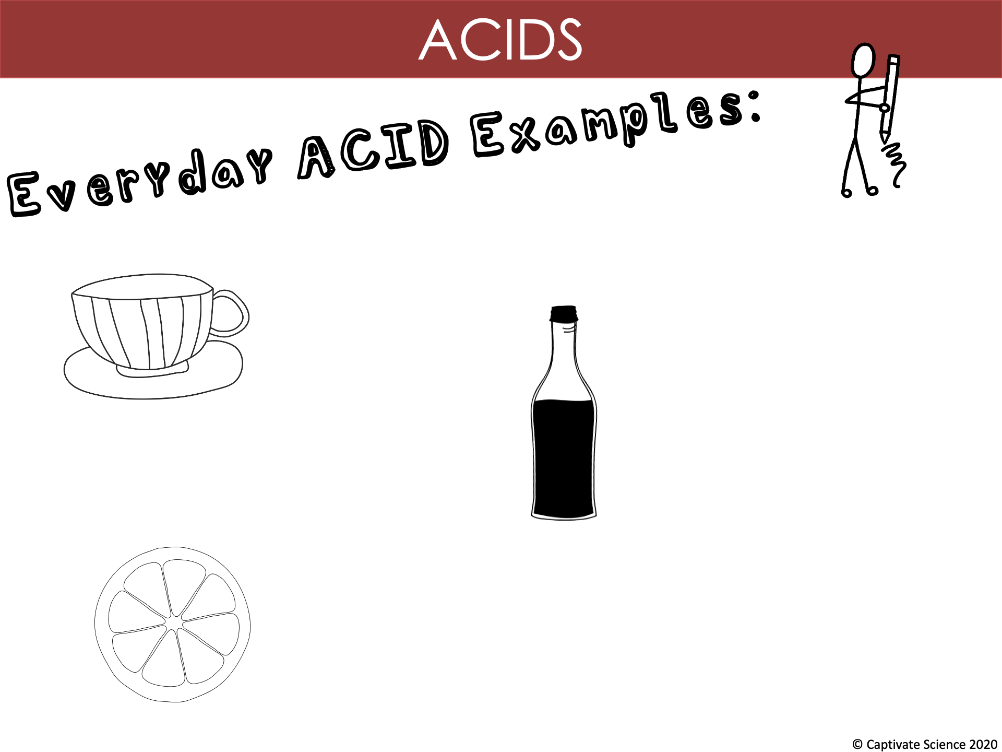
Tea
Vinegar
Citrus Fruit

Slide 12
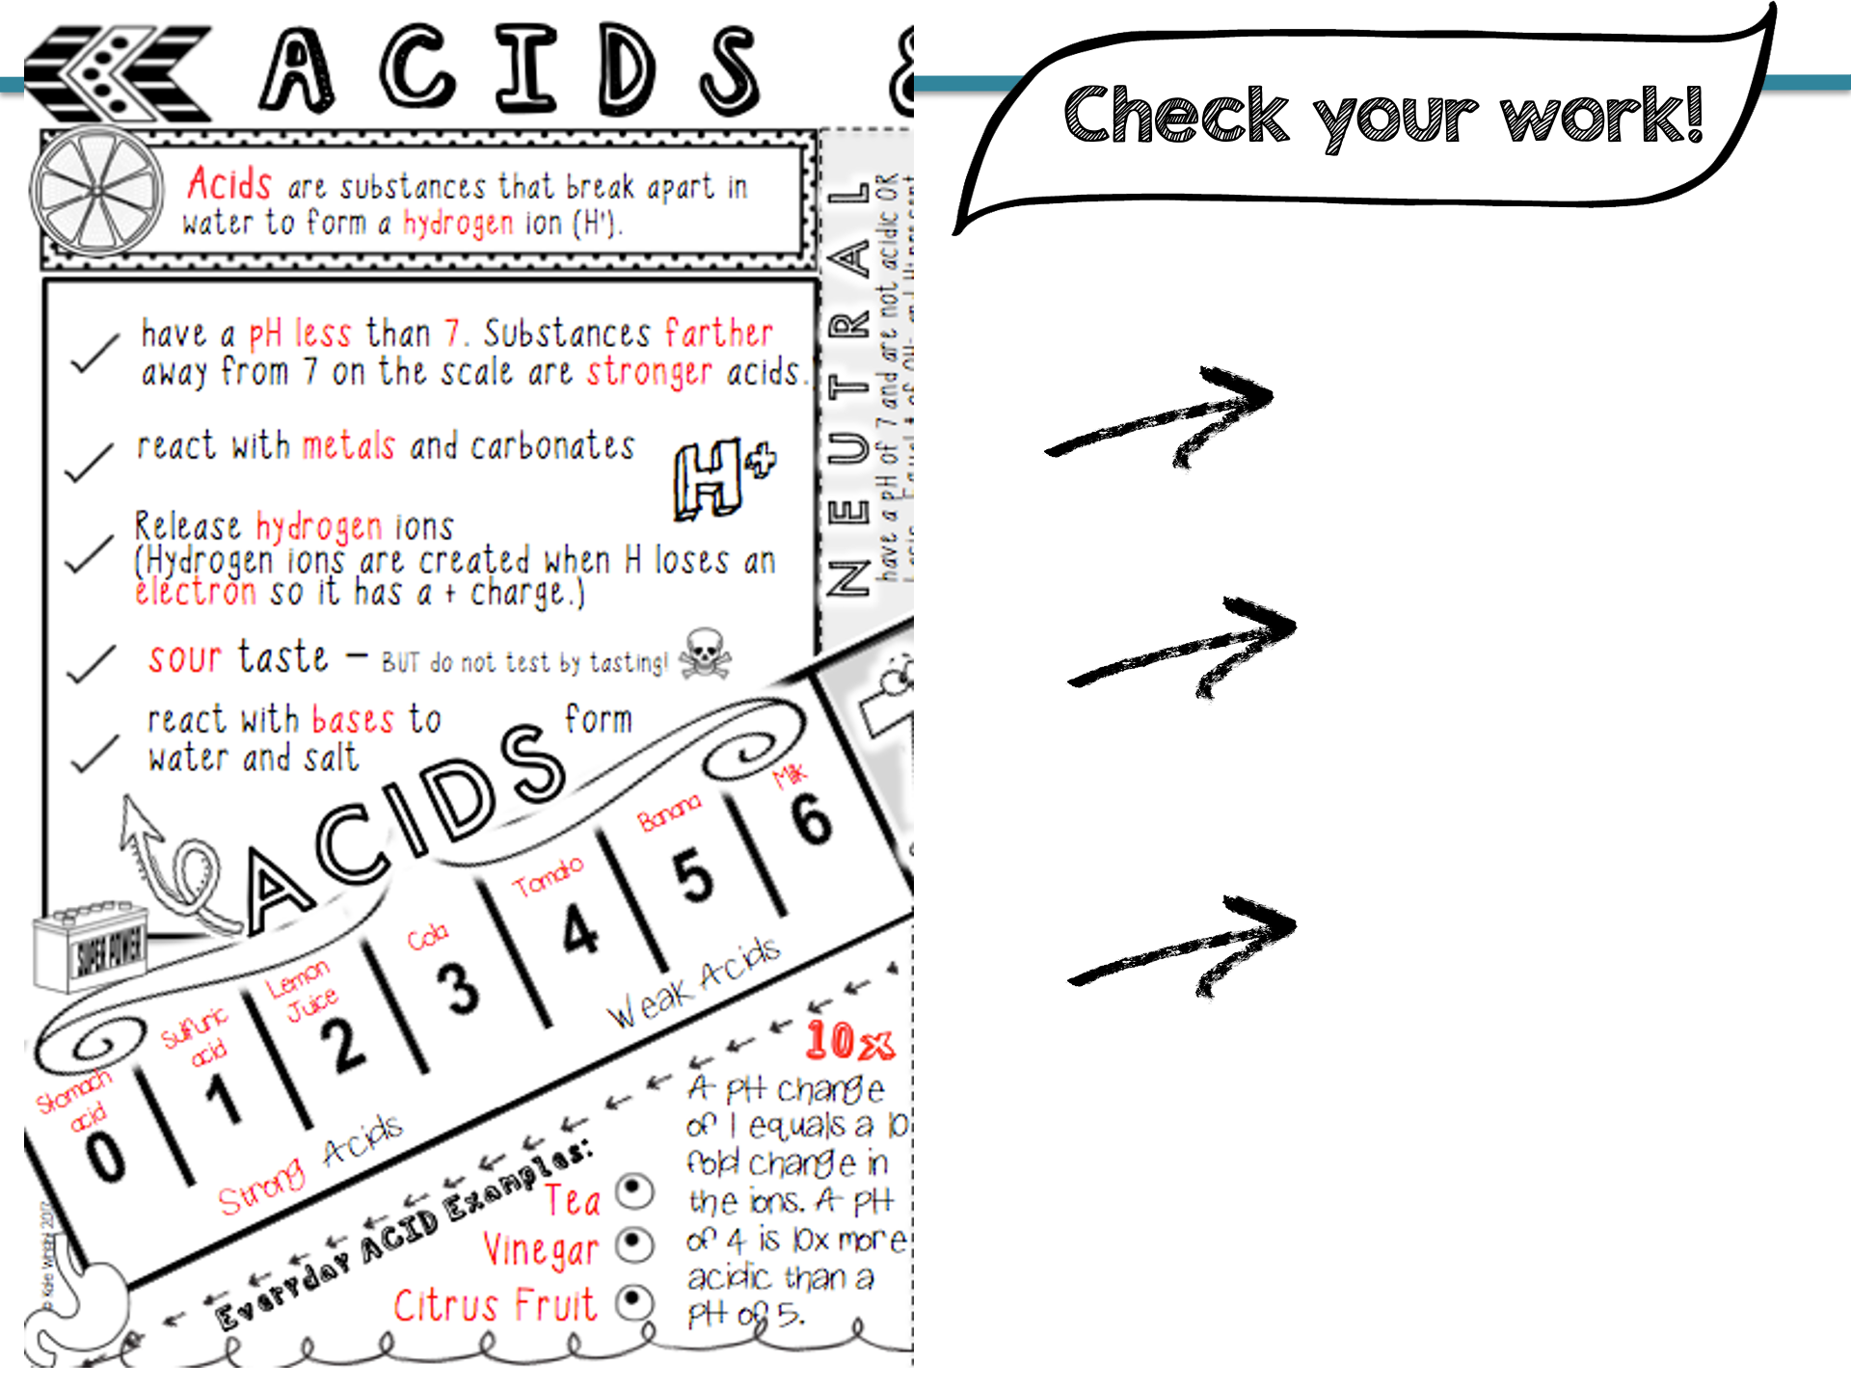
Do you have all the key information? (red)
How do you visualize adding color to emphasize the most important parts?
What facts seem to be easy to remember? What seems more challenging?

Slide 13
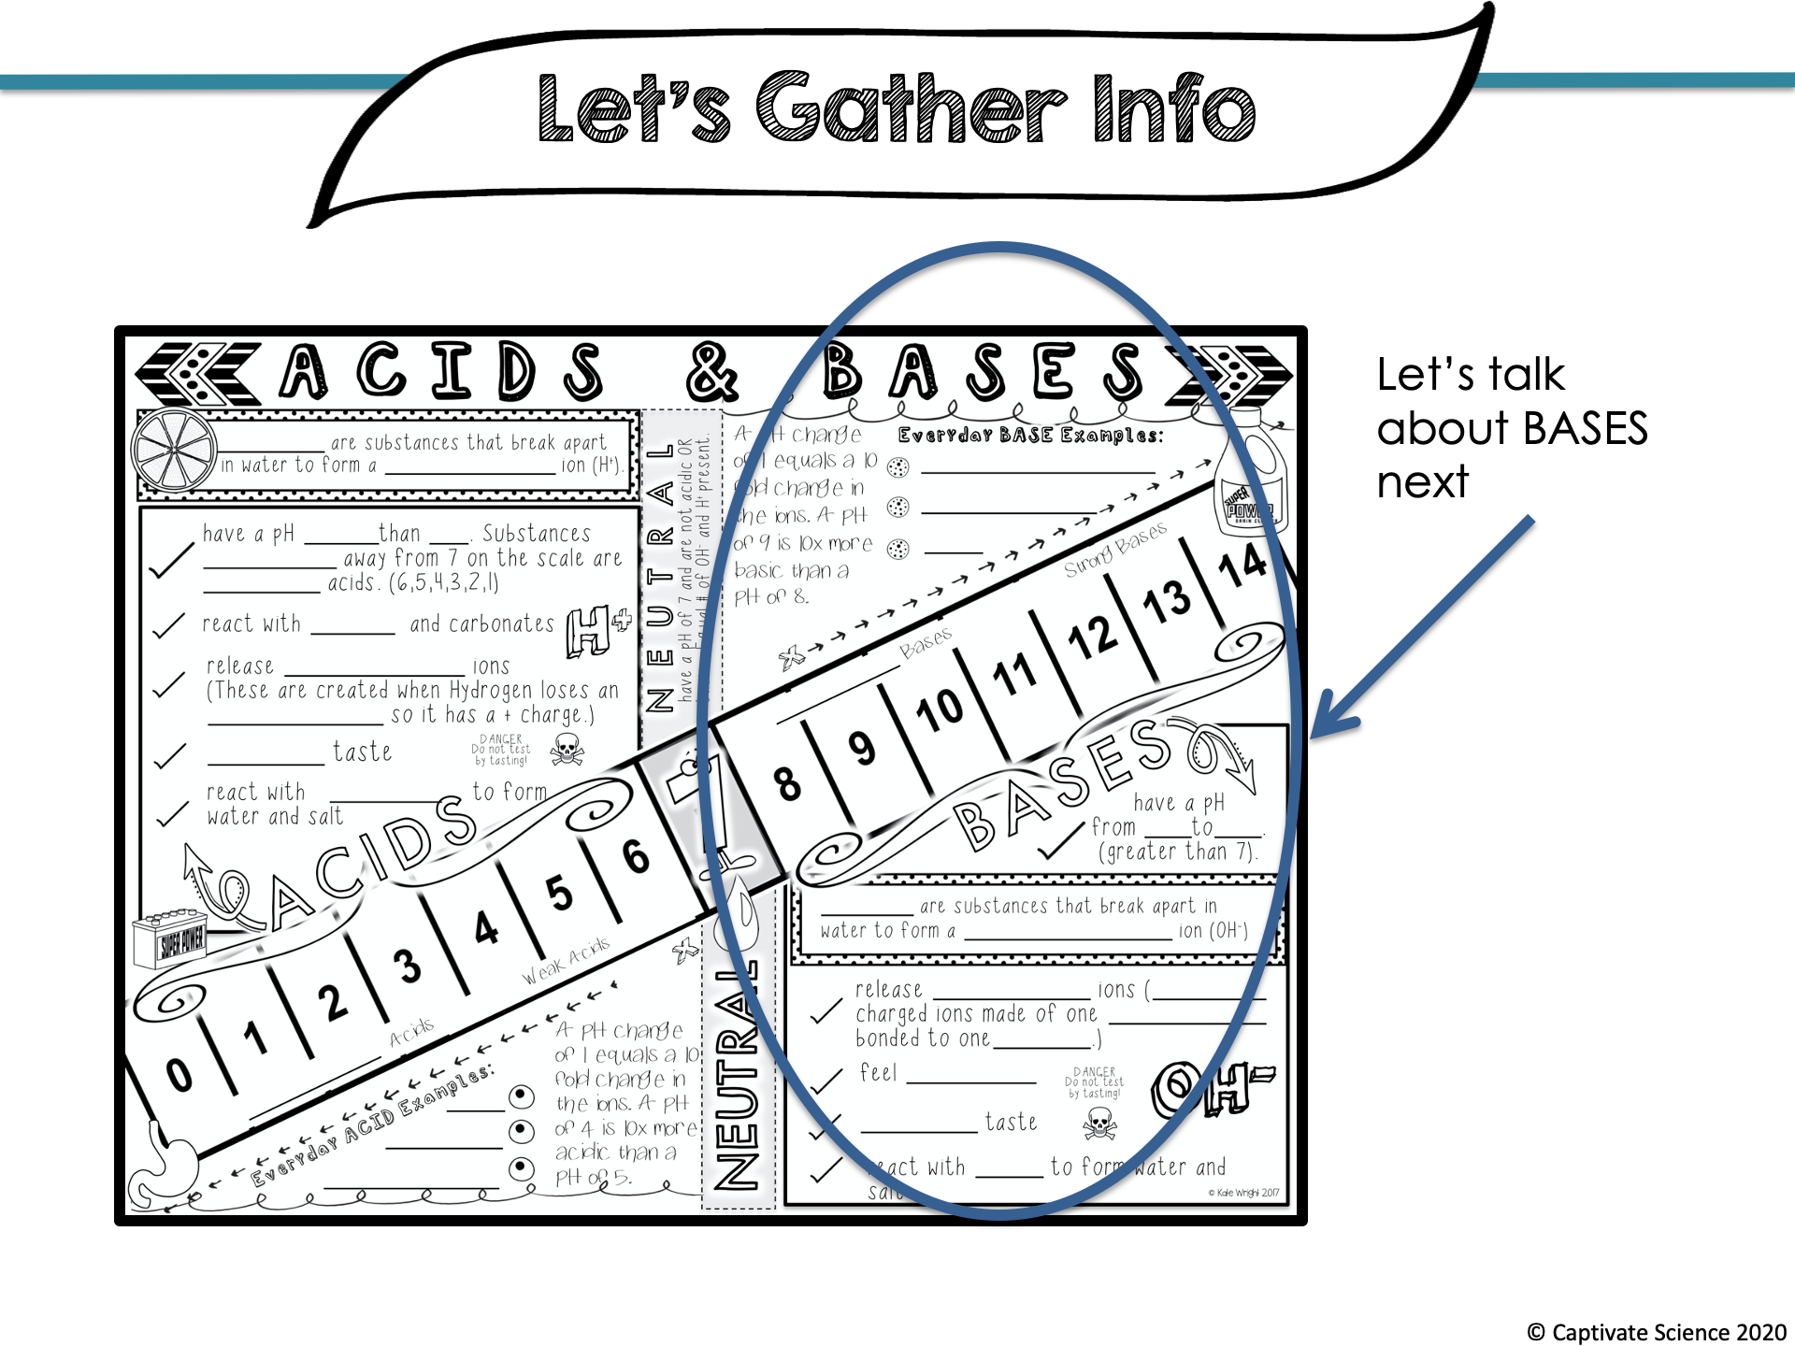

Slide 14
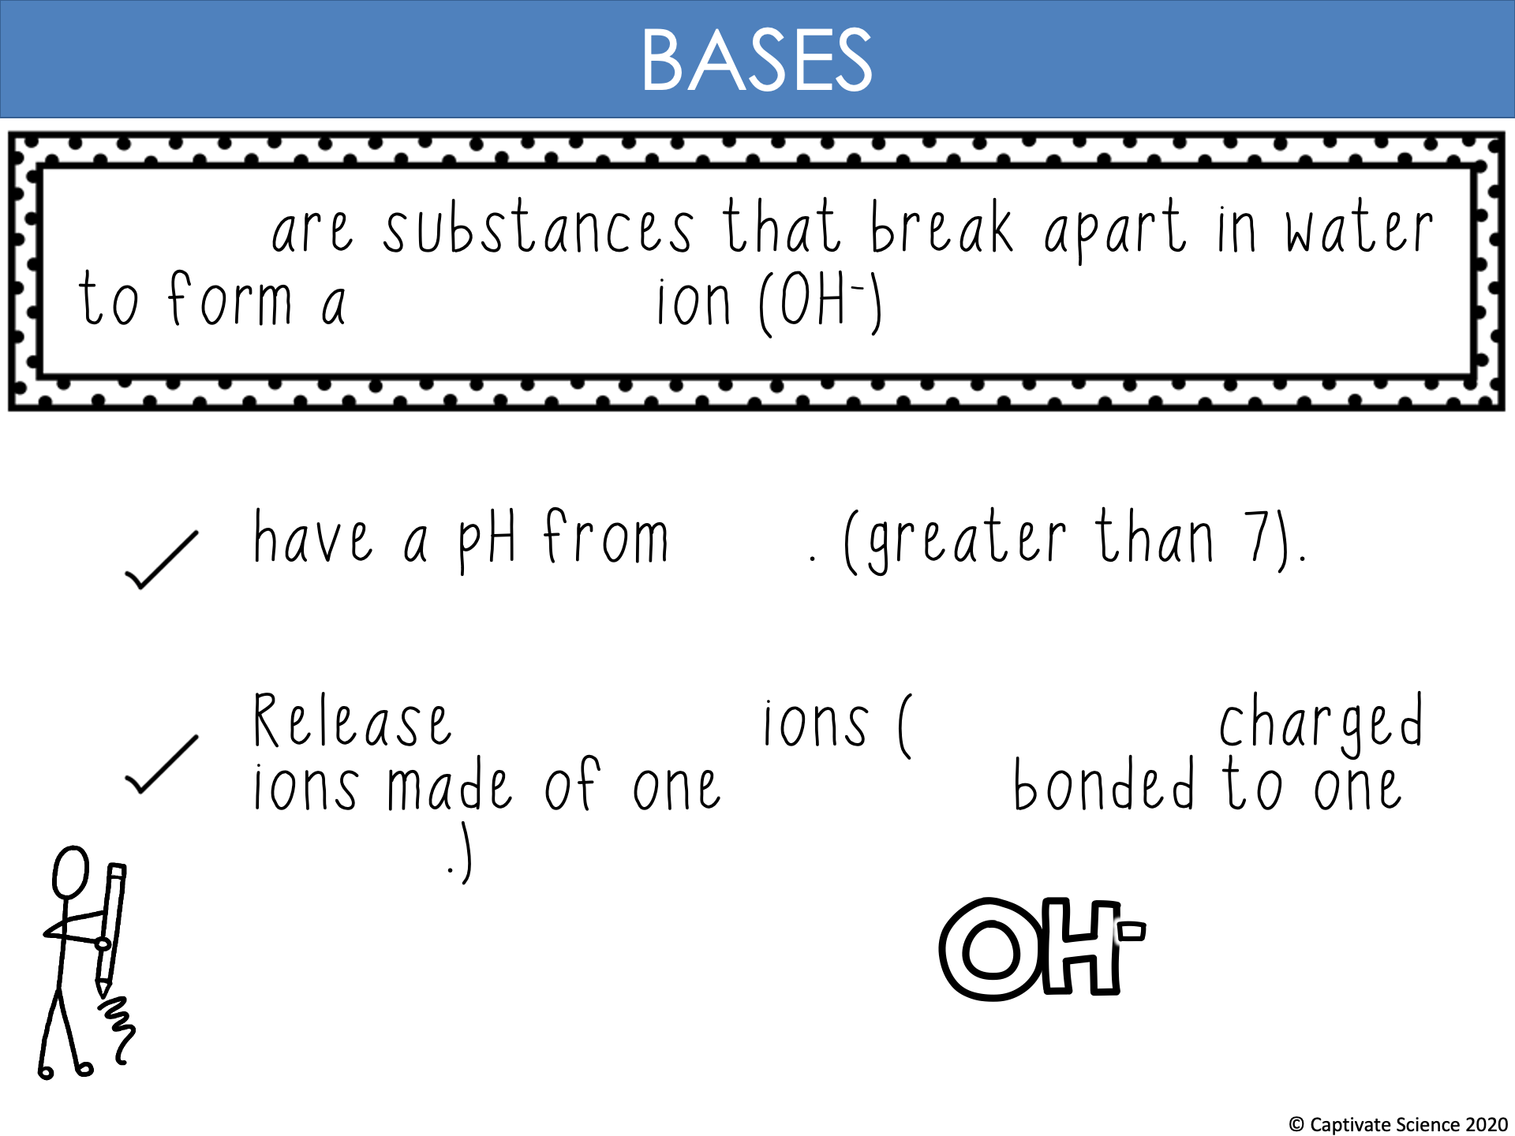
Bases
hydroxide
8-14
hydroxide
negatively
hydrogen
oxygen

Slide 15
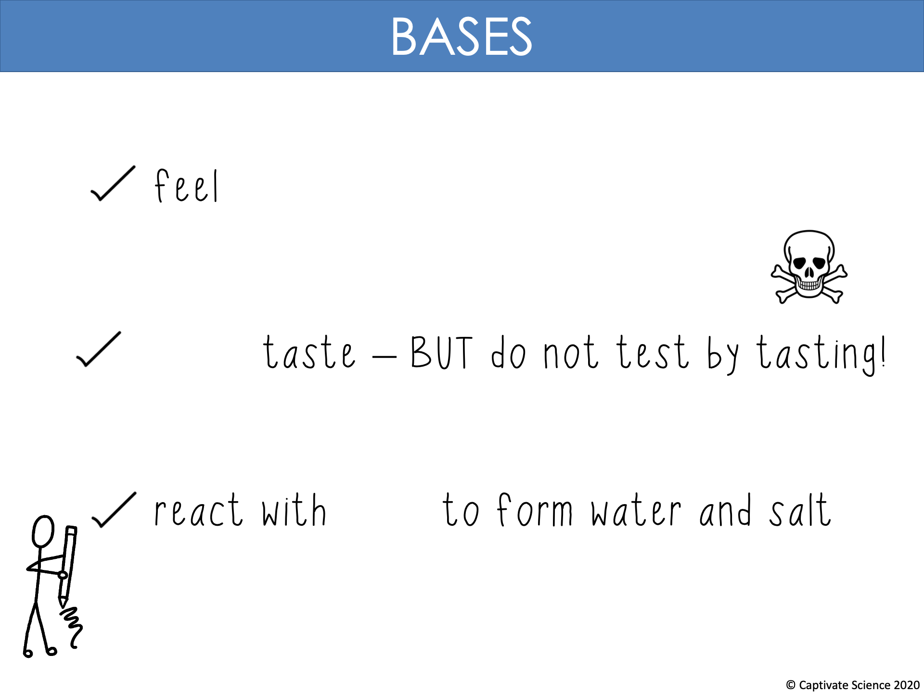
slippery
bitter
acids

Slide 16
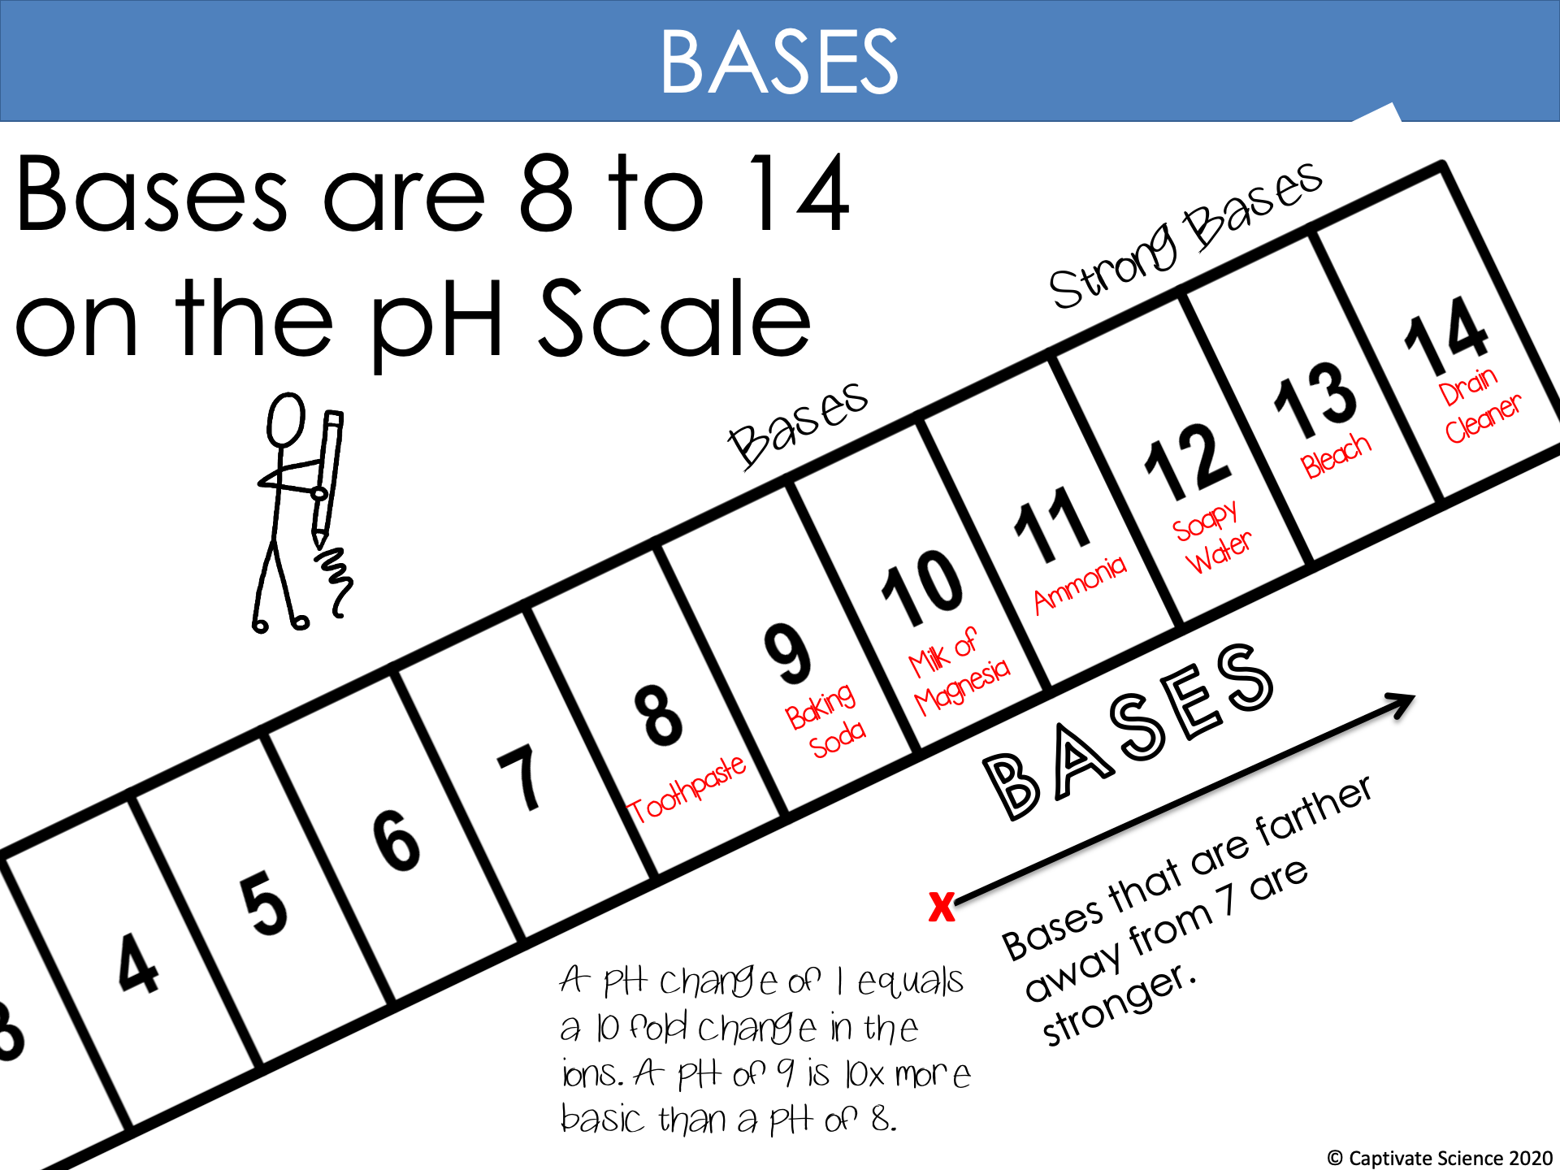
Weak Bases
10x

Slide 17
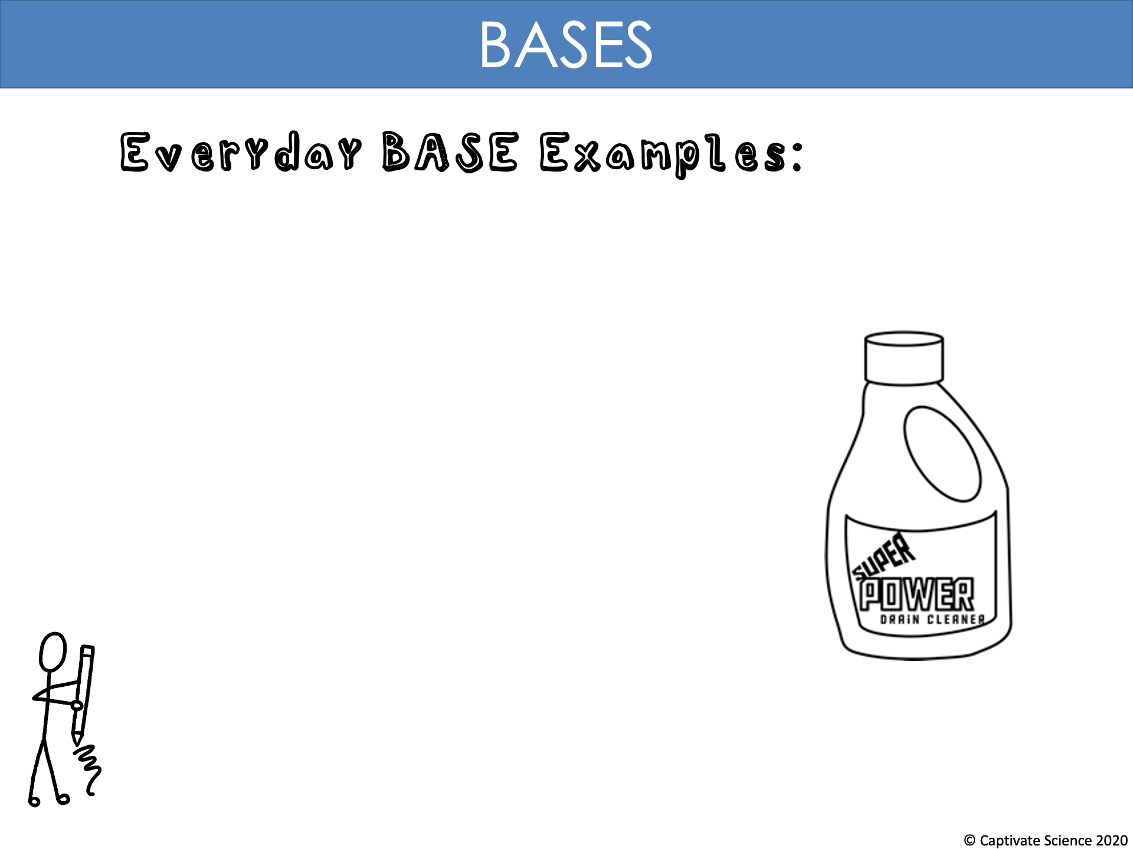
Baking Soda
Bleach
Soap

Slide 18
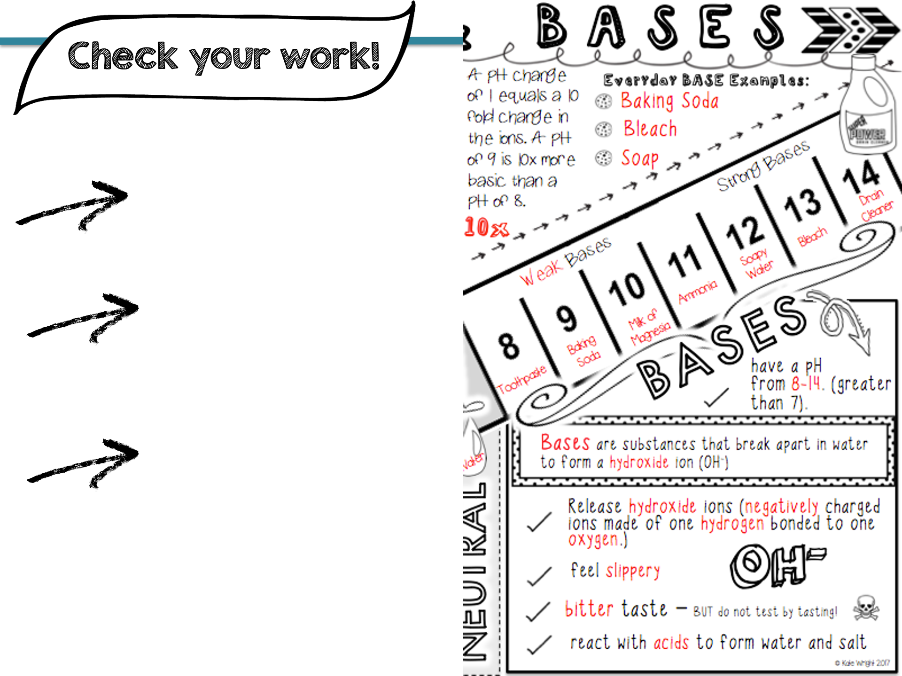
Do you have all the key information? (red)
How do you visualize adding color to emphasize the most important parts?
What facts seem to be easy to remember? What seems more challenging?

Slide 19
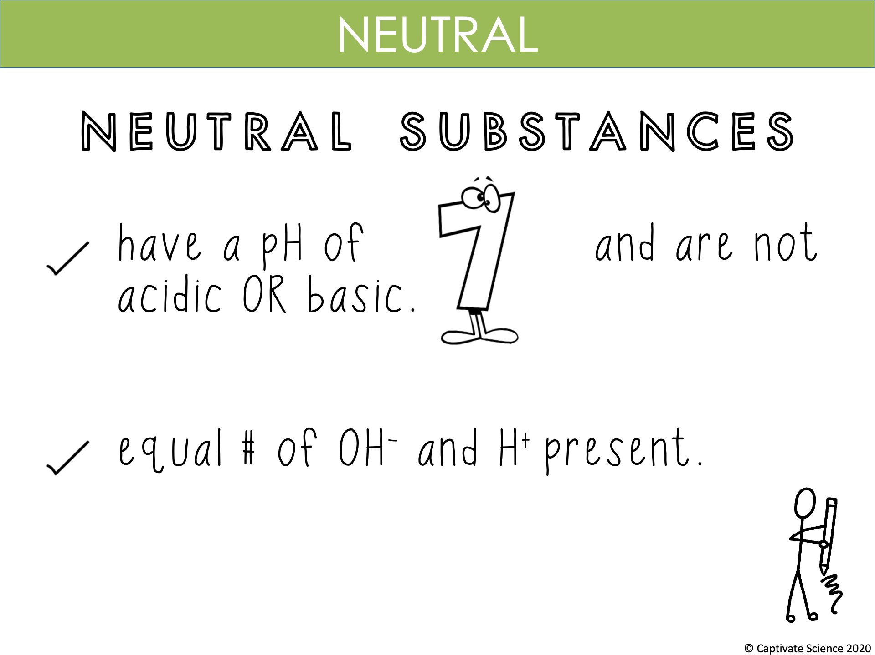

Slide 20
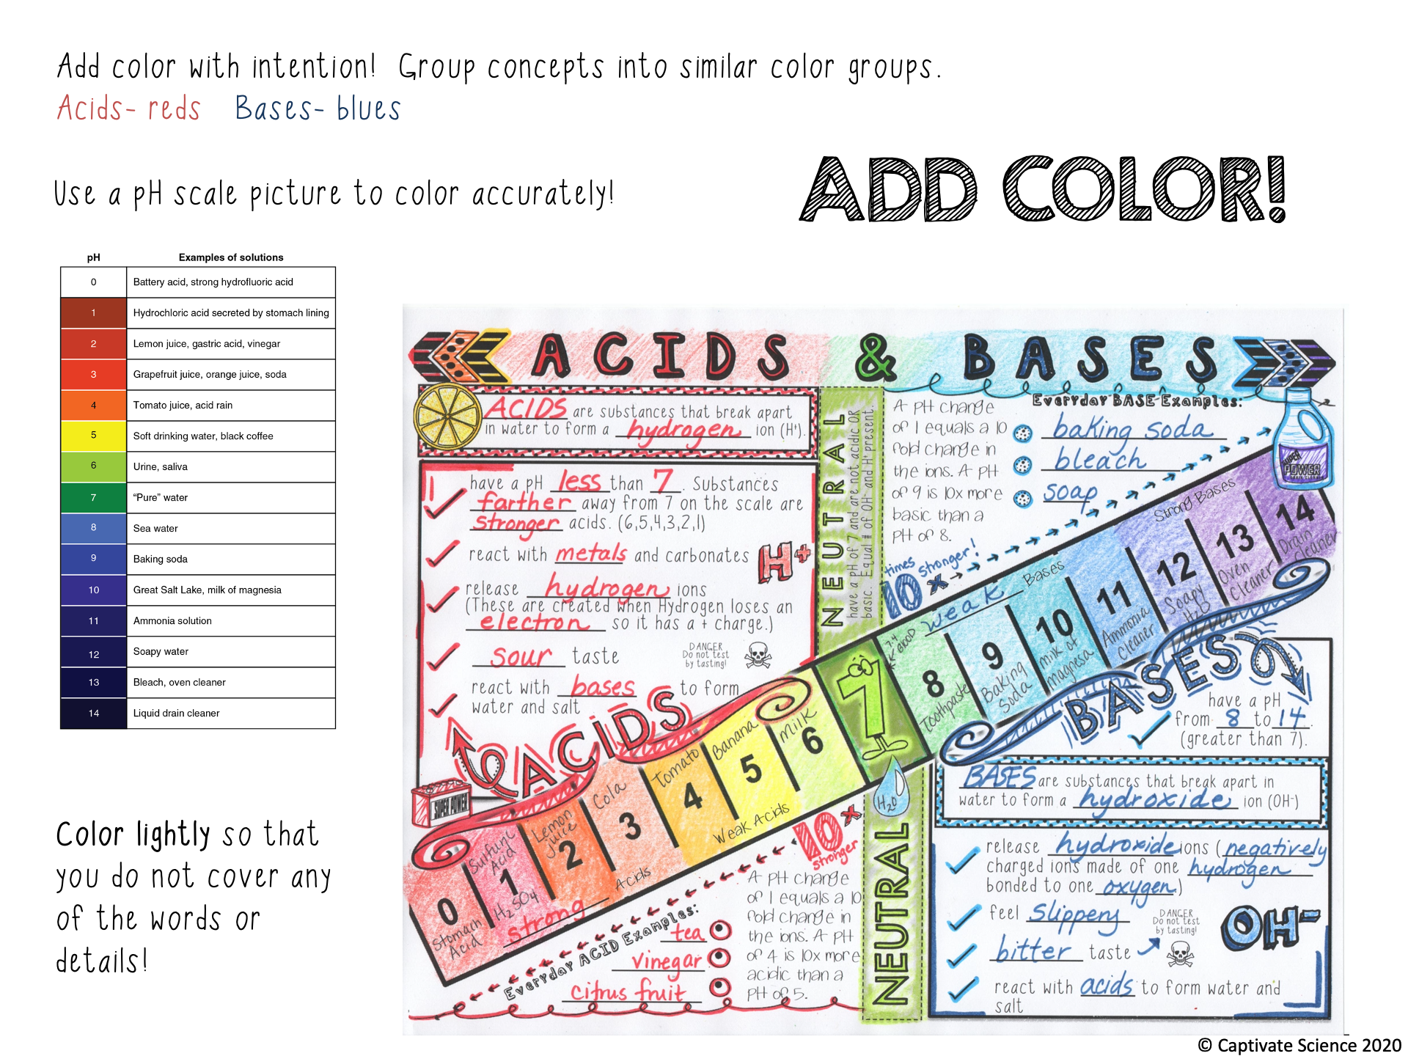

Slide 21
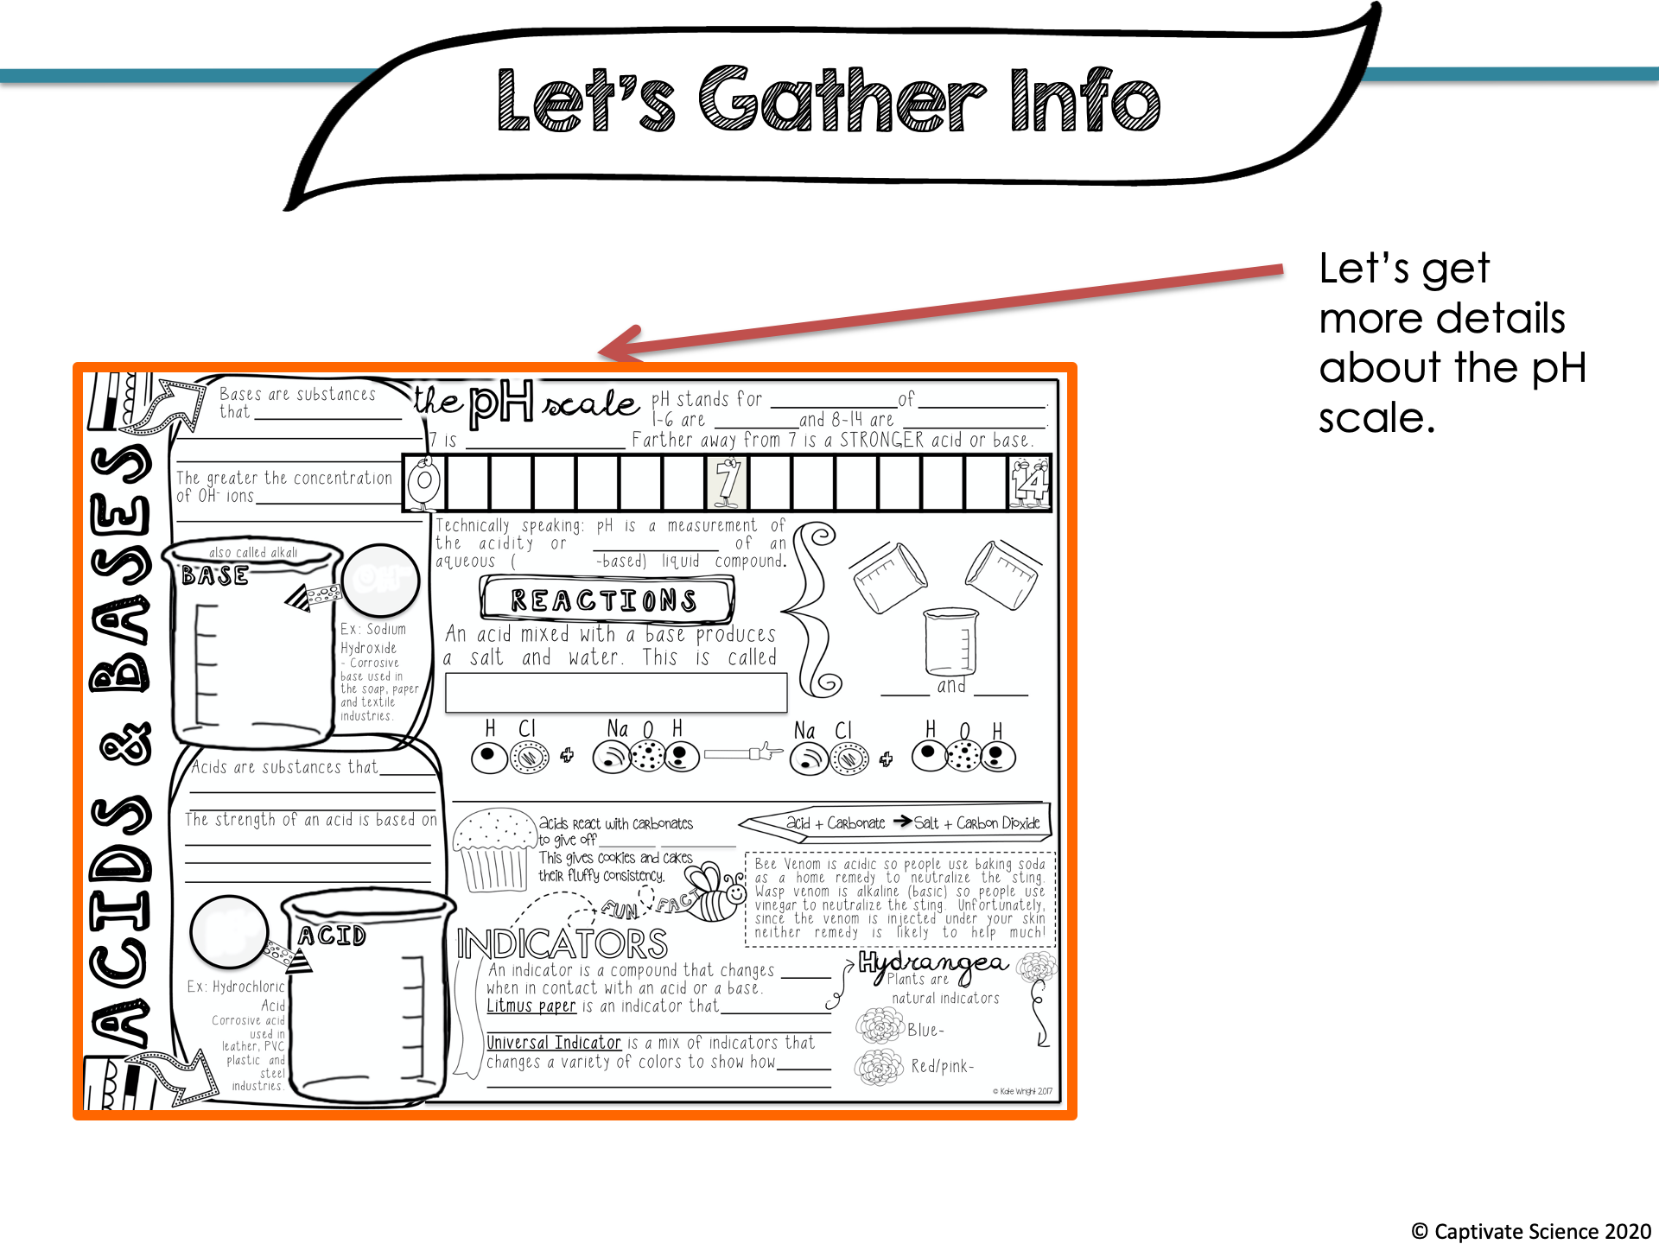

Slide 22
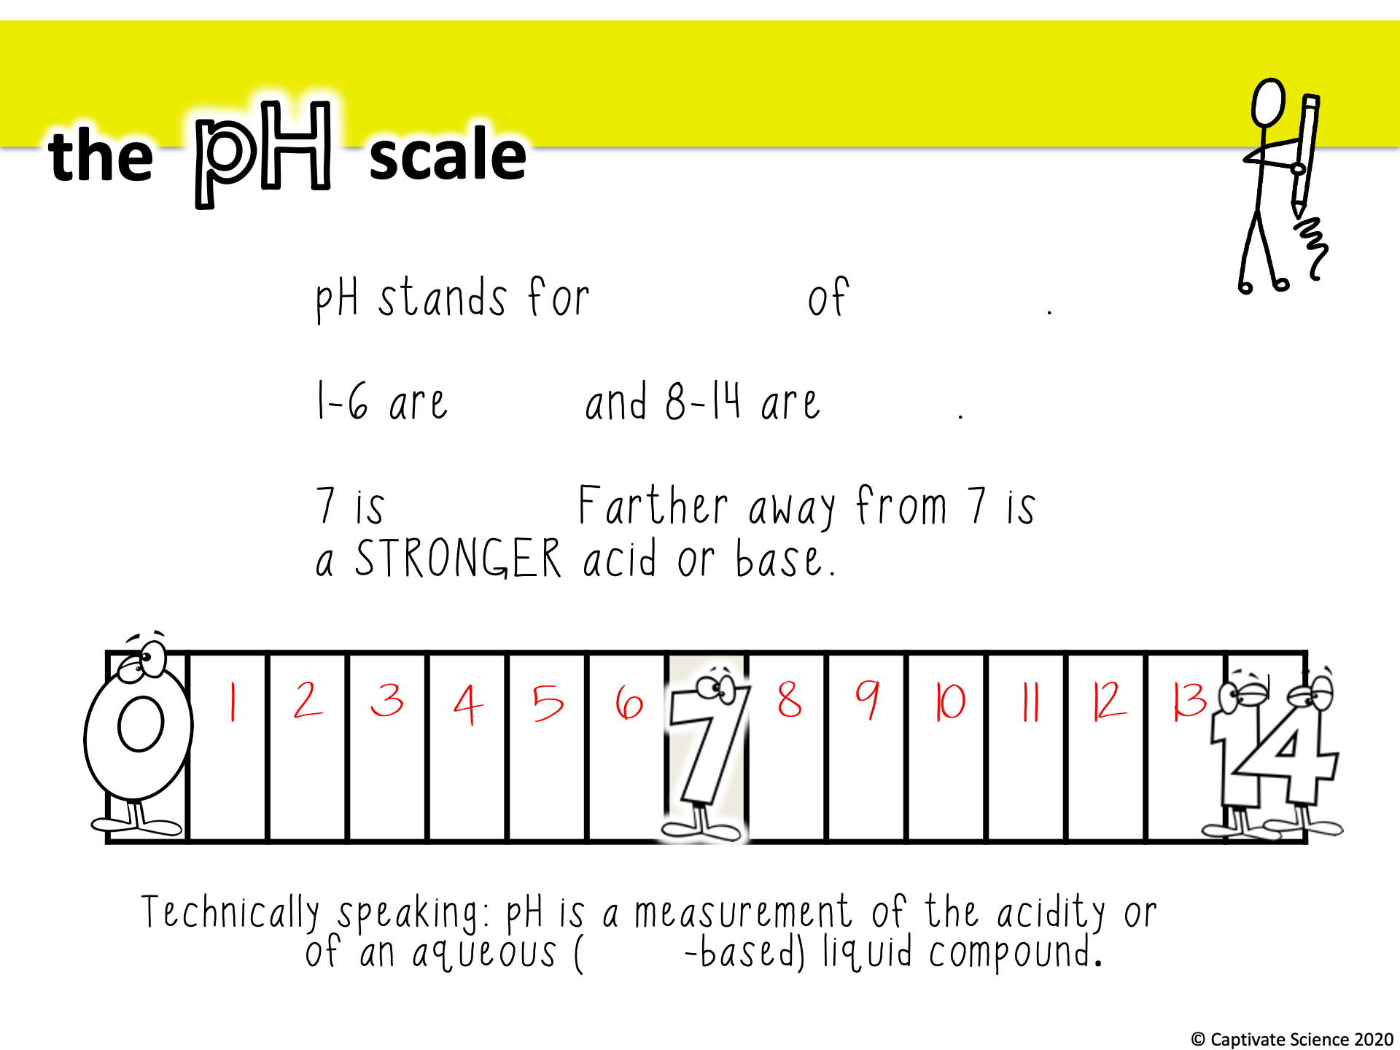
potential
hydrogen
acids
bases
neutral
alkalinity
water

Slide 23
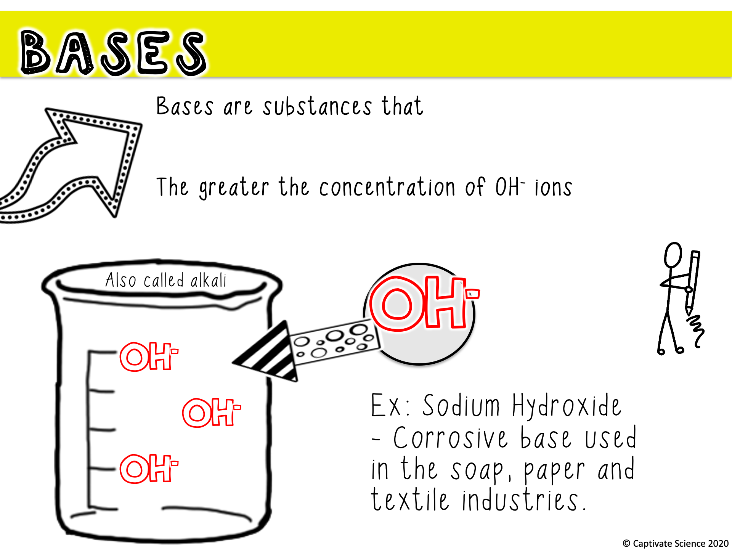
break apart in water to form a hydroxide ion (OH⁻)
the stronger the base.

Slide 24
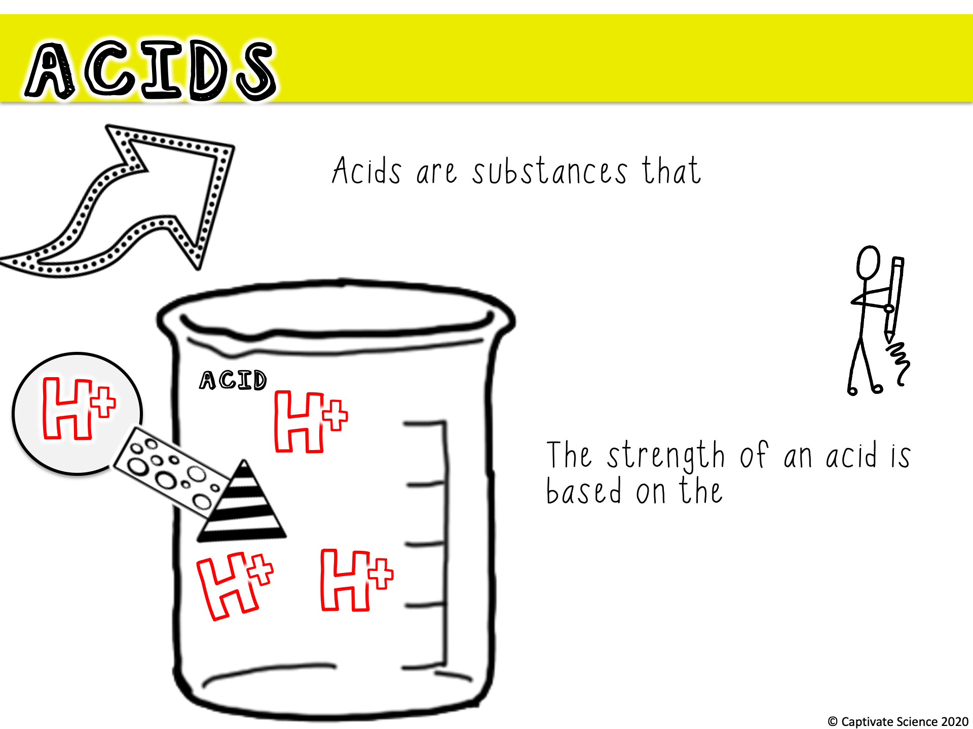
break apart in water to form a hydrogen ion (H⁺)
concentration of H⁺ ions in the solution. The more H⁺ the stronger the acid.

Slide 25
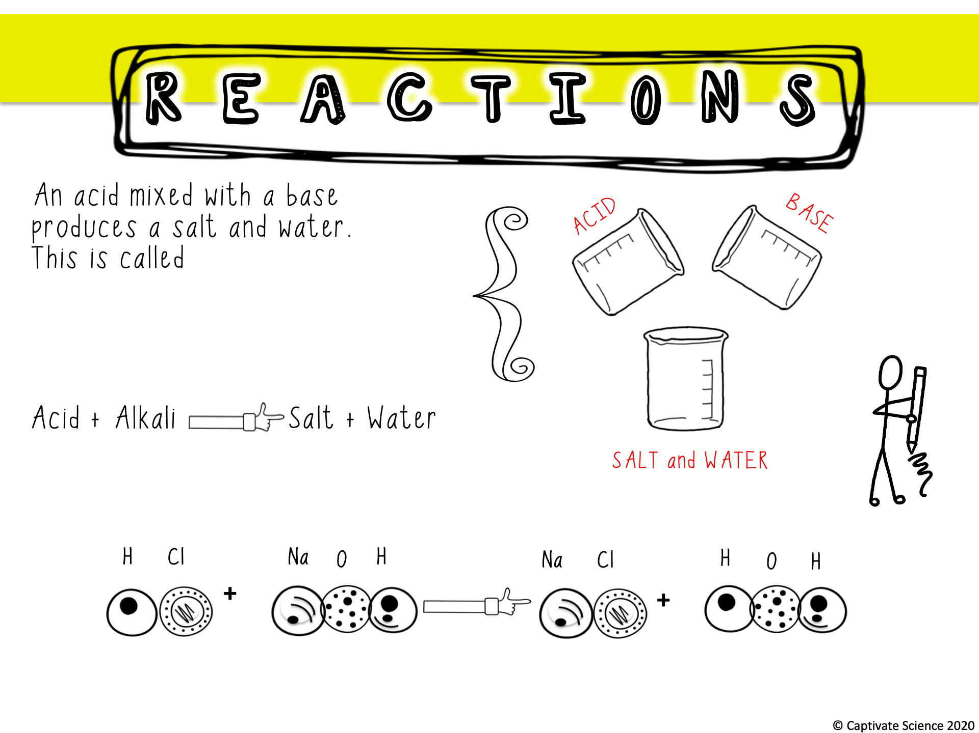
NEUTRALIZATION
Hydrochloric Acid
Sodium
Hydroxide
Salt
Water
Notes:
https://youtu.be/giuUtCj6wQs
Video link to this neutralization reaction being done.

Slide 26
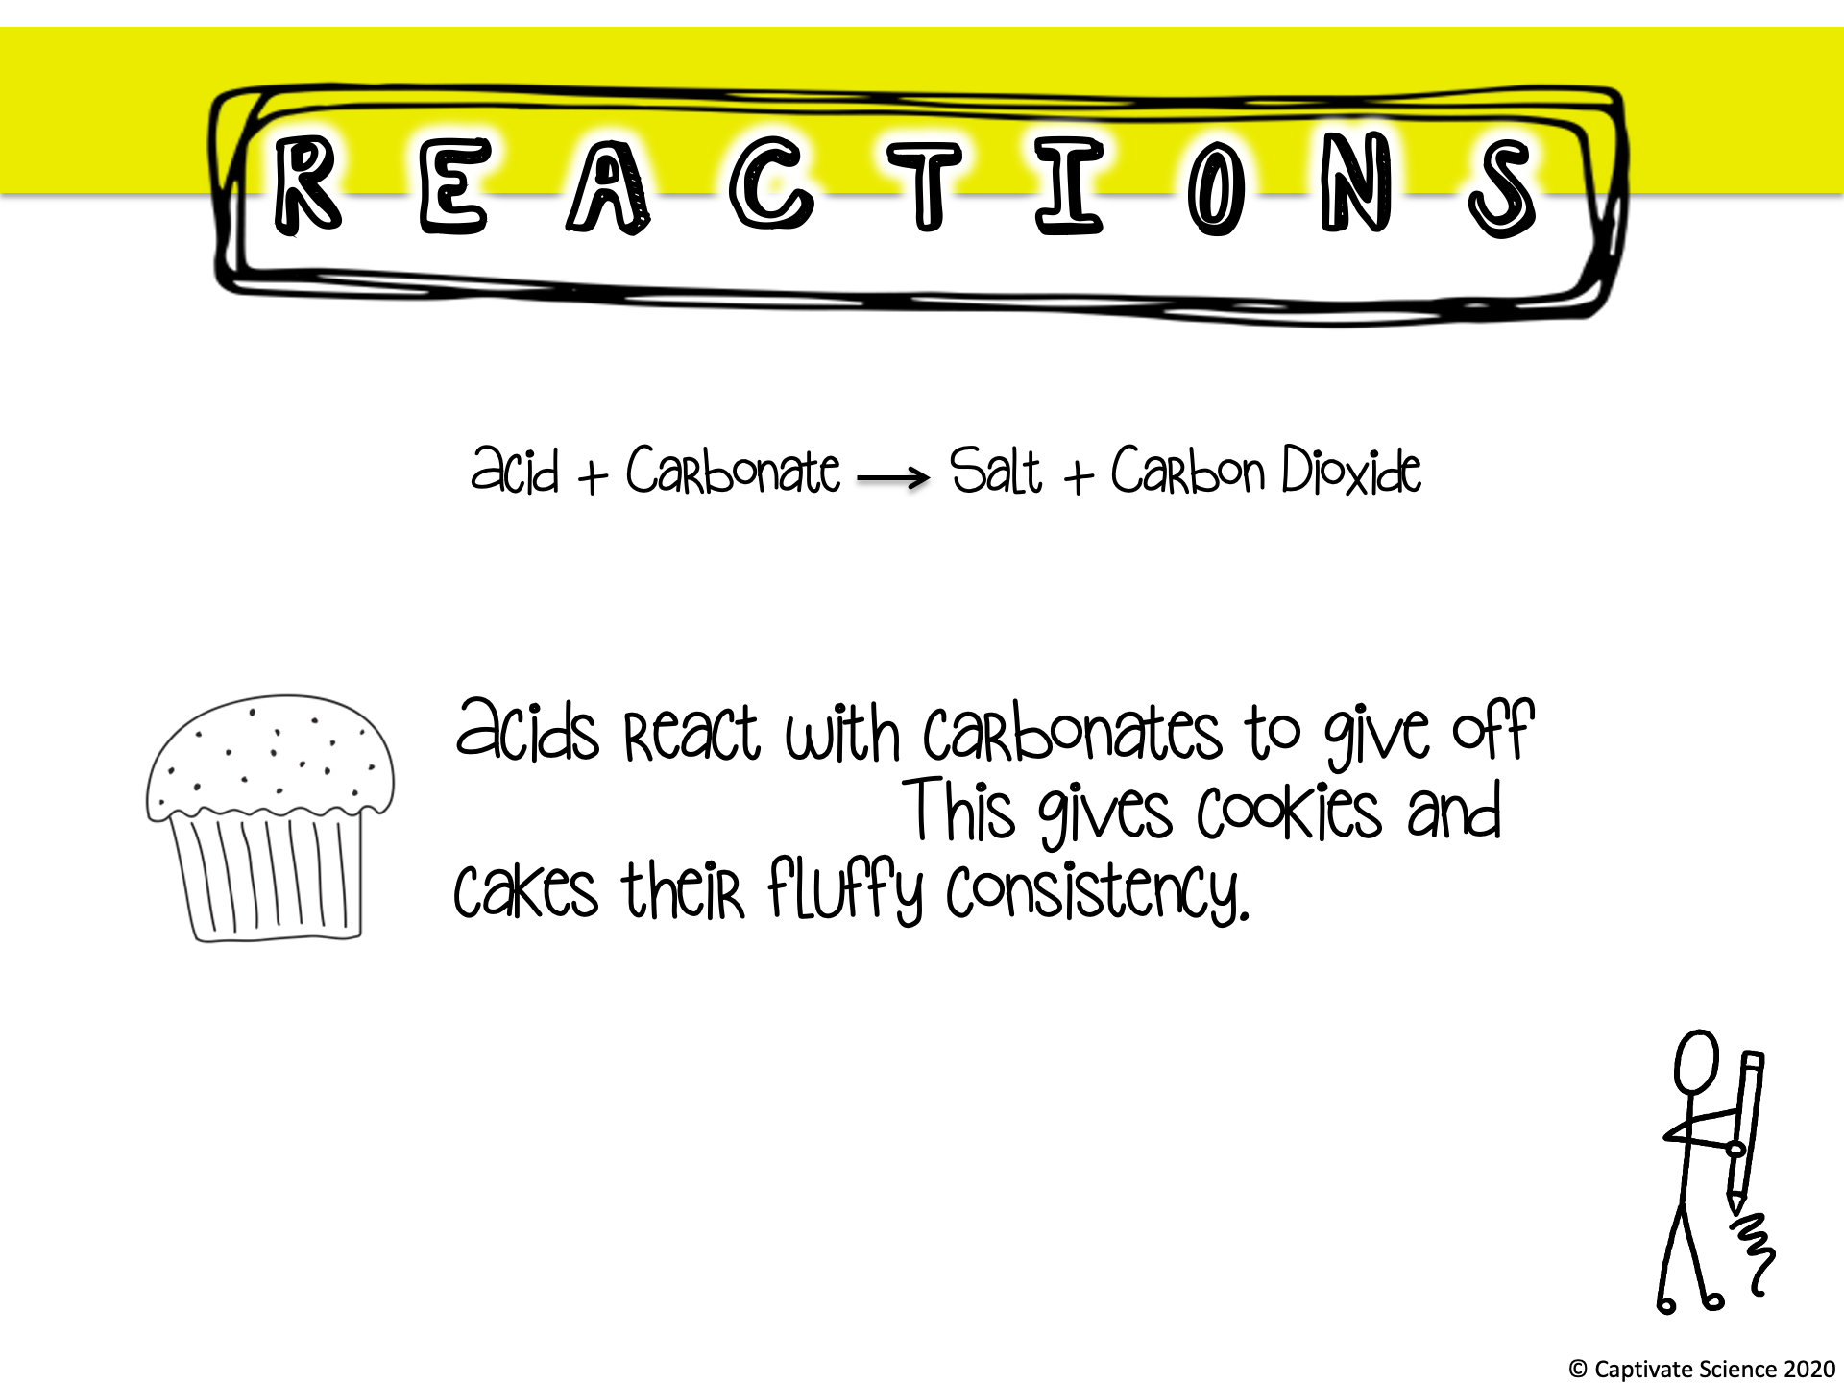
Carbon Dioxide.

Slide 27
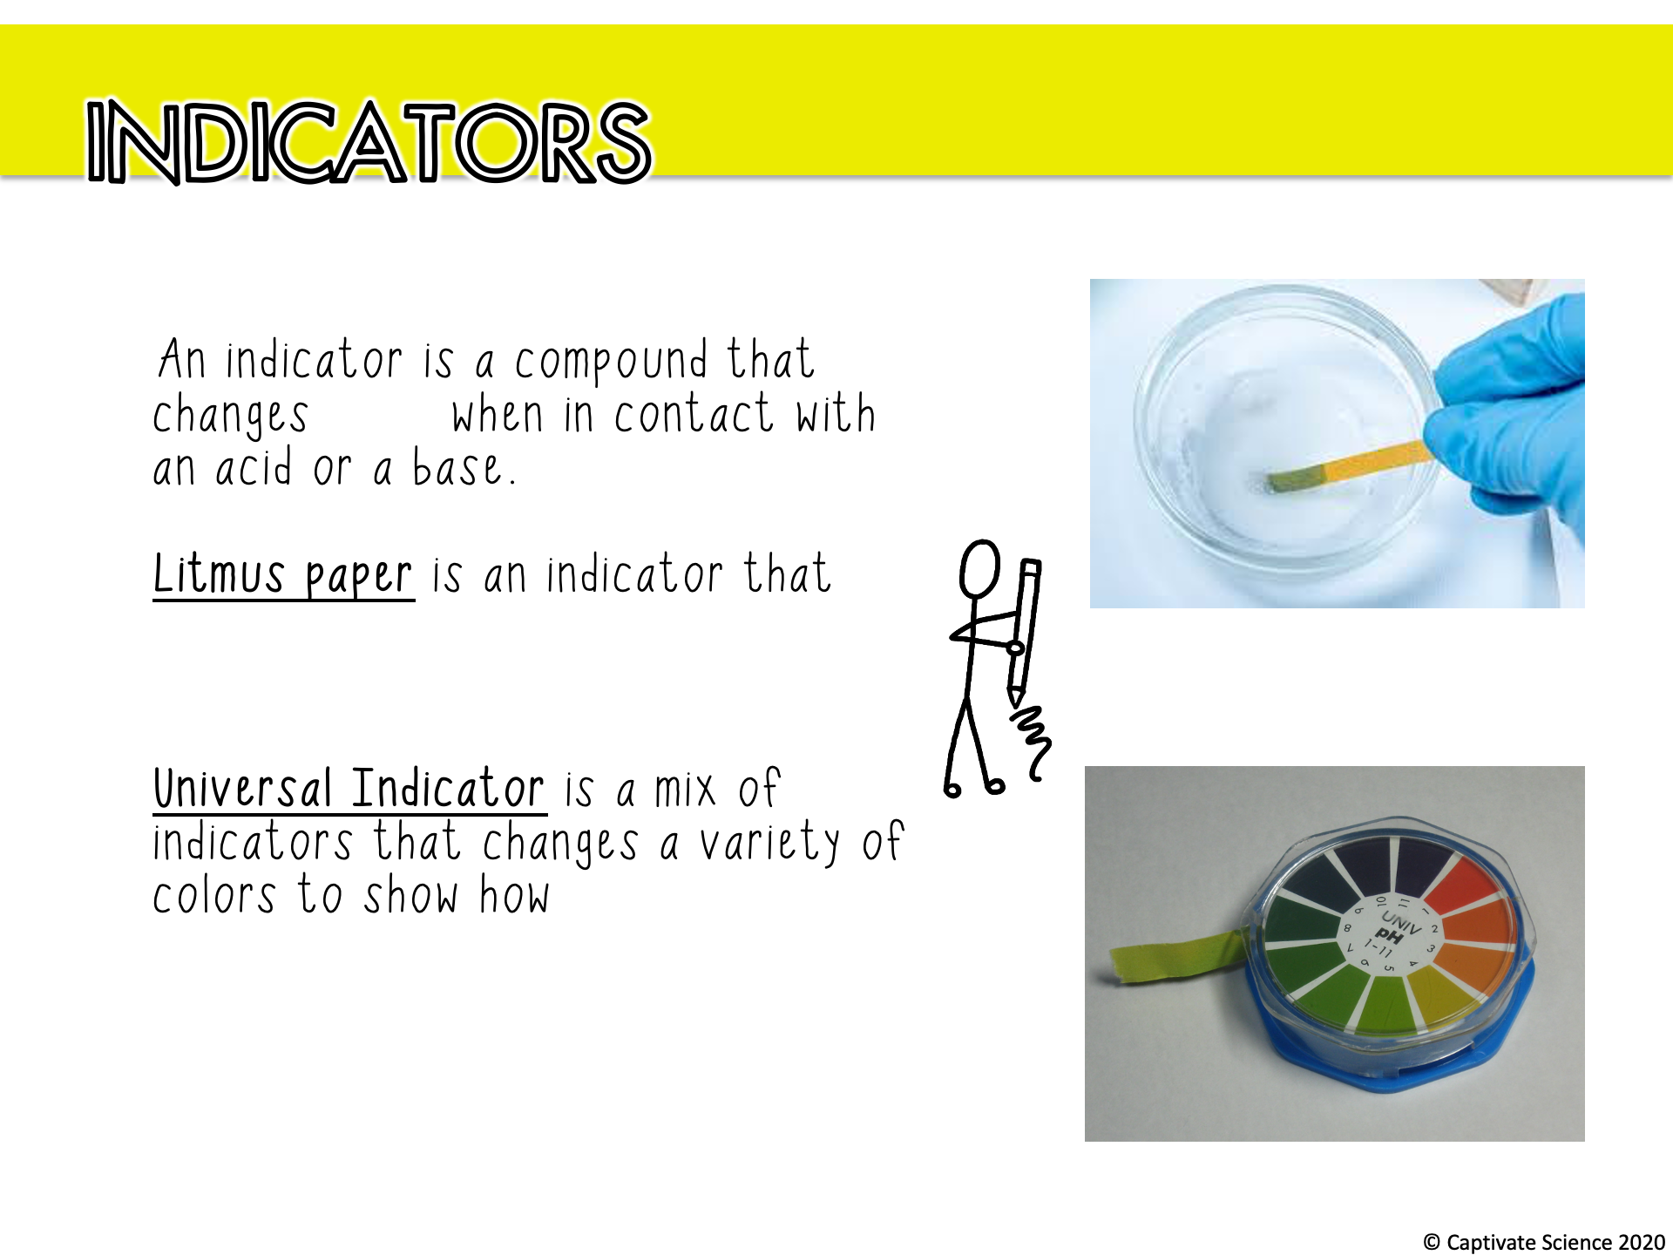
color
turns RED in an acid and
BLUE in a base.
strong or weak an acid or base is.

Slide 28
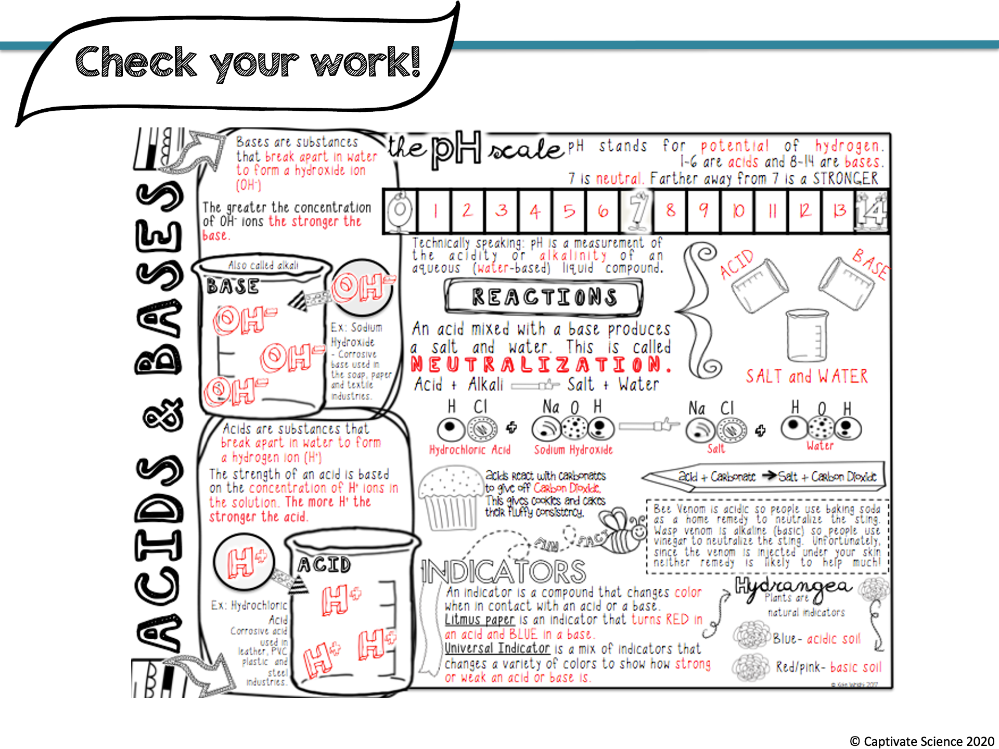

Slide 29
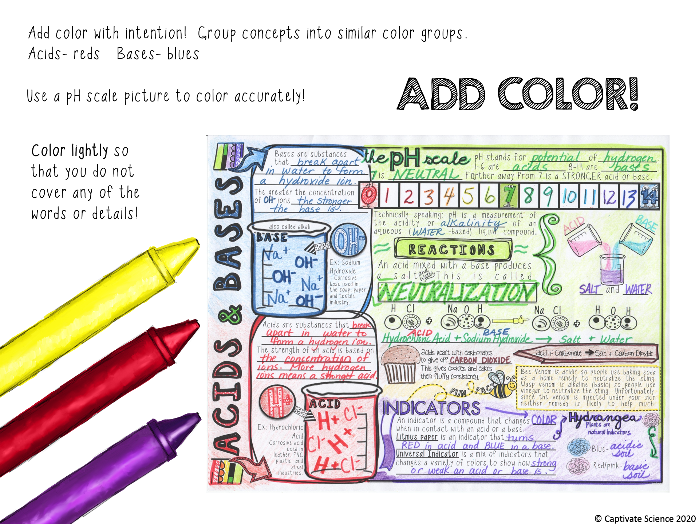

Slide 30

Now that you know more about pH, acids and bases…
What do you think the pH of pool water needs to be in order for Chlorine to do its job? Pick a number from 0-14 (decimals are ok) and explain your reasoning.
Notes:
Ideally pH in a pool should be 7.4-7.6, explanations will vary but should be based on information discussed in the doodle notes.

